Slide 1
Graph color

Slide 2


Slide 3


Slide 4
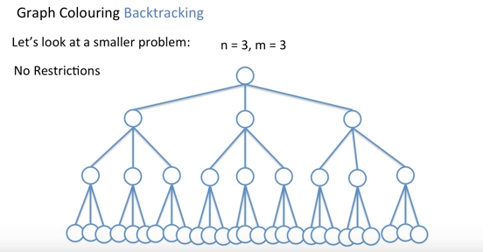

Slide 5
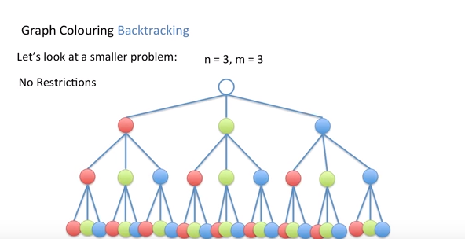

Slide 6
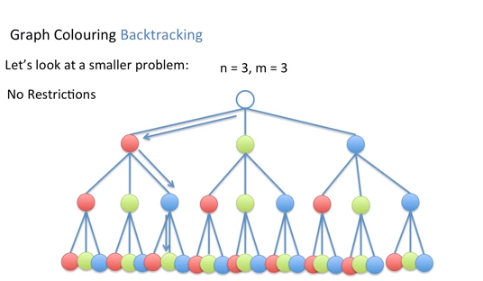

Slide 7
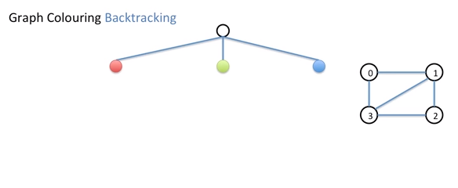


Slide 8



Slide 9
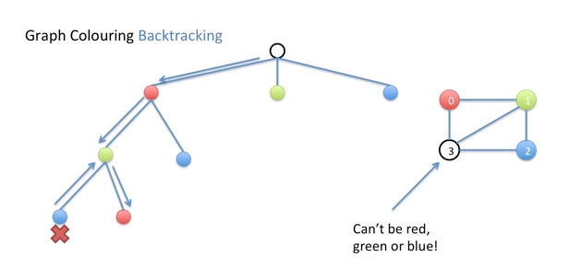
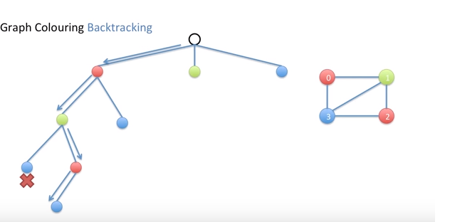

Slide 10
Algorithm
1. Color first vertex with first color. 2. Do following for remaining V-1 vertices. ….. a) Consider the currently picked vertex and color it with the lowest numbered color that has not been used on any previously colored vertices adjacent to it. If all previously used colors appear on vertices adjacent to v, assign a new color to it.

